Slide 1


Data Analysis for
Southeast Airlines
IST 687 M002 Group 3
Zequn Che | Jaishree Palaniswamy | Rashmitha Varma Pandati | Patrick Prioletti | Shreyas Raghavan Sadagopan

Slide 2
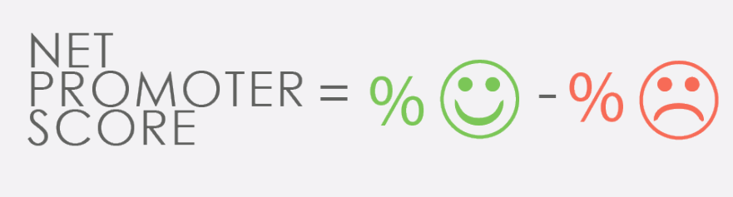
Proposed Plan
In order to Increase the Net Promoter Score of an Airline , We Propose to :
Analyse the Airline Promoter Data to figure out patterns and patterns and trends
Arrive at the variables which have optimum impact on the Likelihood to Recommend of a traveller.
Figure out associations to study Niche groups of travellers and their Likelihood to recommend.
Create meaningful segments of travellers and to study how their Likelihood to recommend varies within that segment with respect to the other variables.
Put forth a solid recommendation on how to Increase the number of Promoters which in turn will affect the NPS Positively

Slide 3
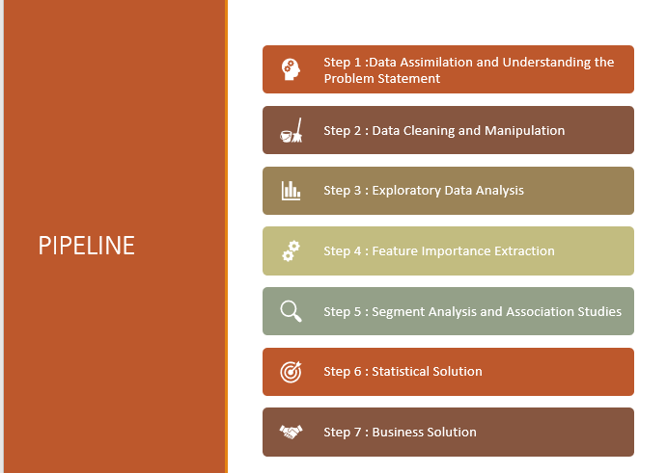
Pipeline

Slide 4
Data Assimilation and Understanding the Problem Statement

Slide 5
The Data Structure
The data set given is at a ‘Flight Journey’ level
The Explanatory variables can be classified into:
Traveller Demographic Variables : Age , Gender etc
Traveller Persona Variables : Price Sensitivity, Loyalty , Amount spent at airports during travel, Frequent Flyer Tags etc.
Air Carrier Variables : Airline partner, Airline Status etc.
Travel Variables : Origin City, Flight Cancelled, Duration , Delay etc.
Other Variables : Latitude, Longitude, Date time etc.
3 . The Likelihood to Recommend is taken as our Y variable for the Analysis.
Total X Vars ; 31 Assumption : Price Sensitivity ranges from (1-5) : Hight to low
Y Var : 1

Slide 6
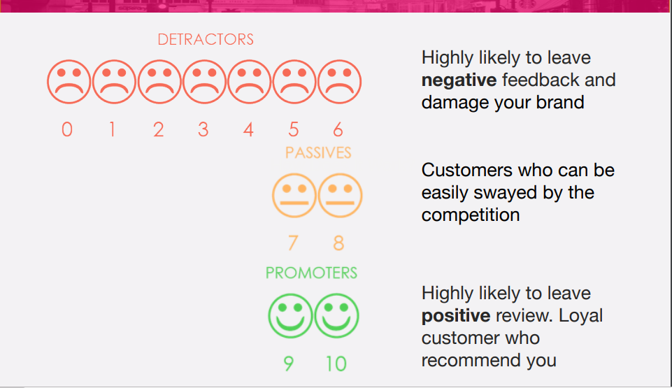
The Y Variable

Slide 7
Business Decisions
Decreasing value of mileage points means we have to look elsewhere for to provide value to the customers.
Looking to NPS for important decisions concerning business relationships, potential investments with staff and airport assets.
Focus on the negatives: Detractors are 1.5 times more likely to stop using a service.

Slide 8
Data Cleaning and Manipulation

Slide 9
Data Prep : Binning
Categorical Variables :
1. All the categorical variables have be converted into factors
Continuous Variables :
1. For Continuous variables with large range,for ex: (AGE), we have followed the below mentioned steps :
Generated the quantiles to look at the distribution
Bucket the variables into 4 to a maximum of 10 levels ensuring there is a pattern in the population across the buckets (Fatter in the middle)
Example : The Age Variable is bucketed as <24 ,25-35, 36-46, 47-58, 57-71, 71+
2 . For Continuous variables with small range we have followed the below mentioned steps :
Generated the quantiles to look at the distribution
Create a maximum of 3 levels ensuring logic and the population density is maintained across the buckets
Example : The Arrival Delay is bucketed as 0 , 0-60 Mins ,60+Minutes

Slide 10
Missing Value Imputation
After the previous step, All our continuous variables have been transformed to character variables.
Converted All the variables as factors.
Imputed NA with the Mode for all the Variables except,
The Arrival and Delay Minutes ,if NA, are set to the level “0” if the corresponding flight is cancelled

Slide 11
Exploratory Data Analysis

Slide 12
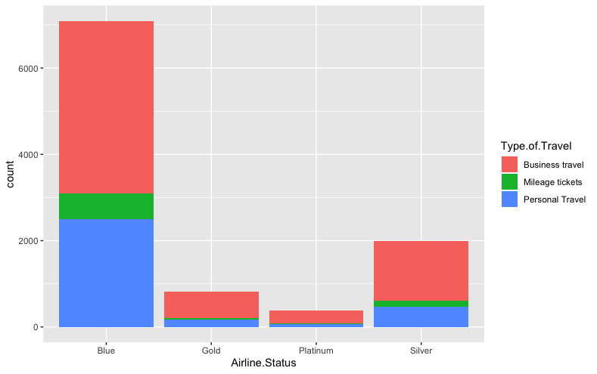
Distribution of airline status passenger levels

Slide 13
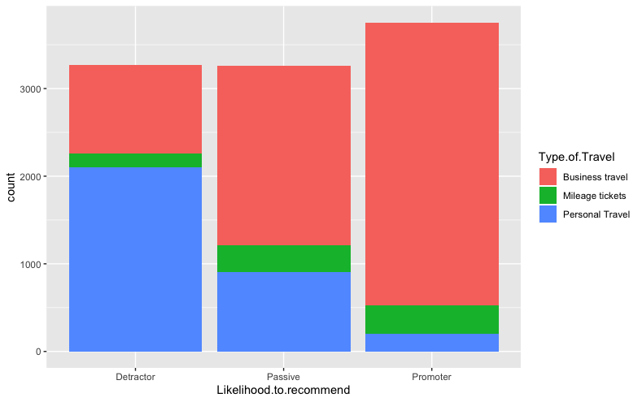
Distribution of NPS levels vs type of travel

Slide 14
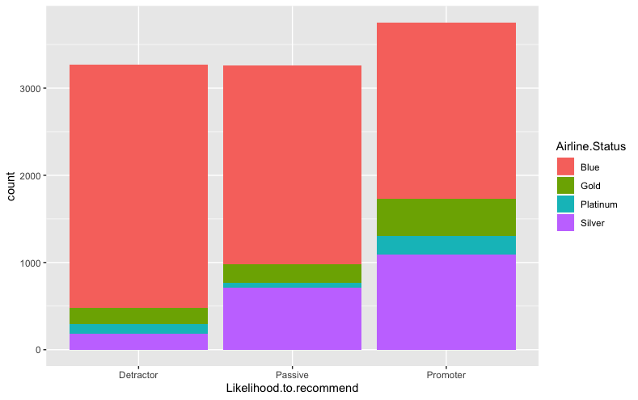
Distribution of NPS levels vs airline status

Slide 15
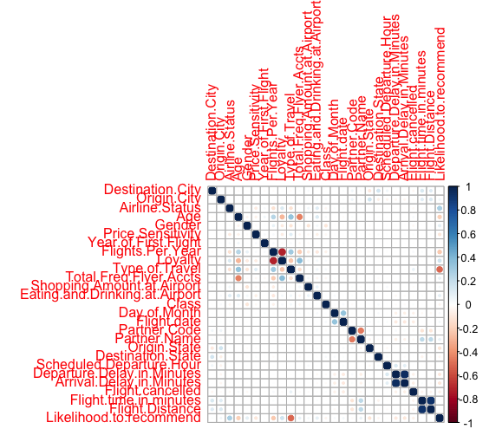
Correlation of All Variables

Slide 16
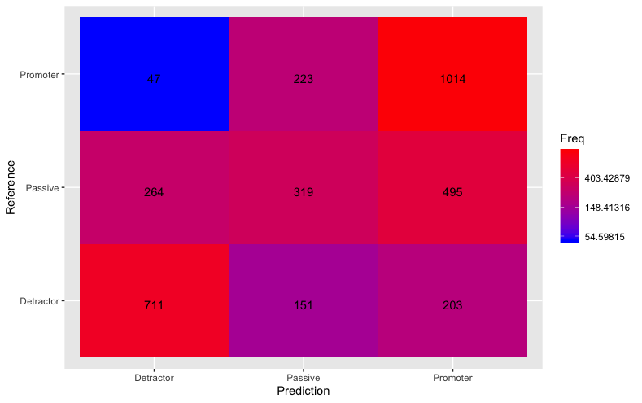
Model:
SVM
Accuracy: 59.64%
95% Confidence: 58%-61%
No-info Rate: 37.5%
Detractor Passive Promoter
Sensitivity 0.6676 0.29592 0.7897
Specificity 0.8683 0.84078 0.6743

Slide 17
Feature Importance Extraction

Slide 18
Variable Selection Process
1 . Reduction Using Business Logic and Correlation matrix:
Removed variables which have more than multiple levels Date, Latitude/Longitudes, Origin and Destination city
Removed Eating amount spent, Shopping at airport,Partner code with respect to the Corr Matrix and business requirements
Total variables 16 at the End of this Step

Slide 19
Variable Selection Process
2. Feature Importance Generation to find the most significant Variables
In order to get optimum Feature Importance, we have built 3 models
Logistic Regression
Random Forest Classifier
Gradient Boost Classifier
We compare the Relative Importance in each of the models to figure out the best combination of variables

Slide 20
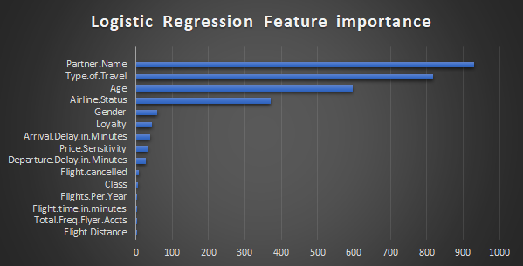
Models : Logistic Regressor
Model Stats : Gave a 74 % Accuracy when validated using a test set.
AUC: 0.8376627

Slide 21
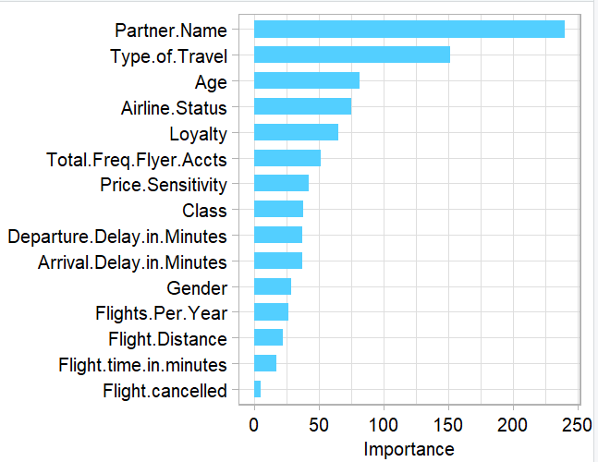
Models: randomForest Classifer
Model Stats : Gave a 75.564 % Accuracy when validated using a test set.
AUC: 0.8376627

Slide 22
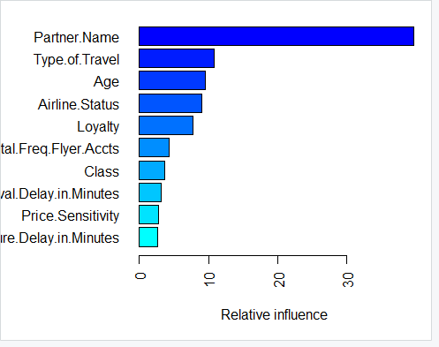
Model: Gradient Boost Classifier
Model Stats : Gave a 75.564 % Accuracy when validated using a test set.
AUC: 0.8376627
A gradient boosted model with gaussian loss function.
5000 iterations were performed.The best cross-validation
iteration was 80.There were 15 predictors
of which 13 had non-zero influence.

Slide 23
Inference From the Feature Extraction Exercise:
We see that the following variables have high feature importance across all the 3 classifiers. We pick the top 8 common Variables to base our analysis on for the further steps.
PartnerName
Age
Airline Status
Type of travel
Loyalty
Total freq Flyer
Price Sensitivity and
Class

Slide 24
Segment Analysis and Association Studies
USING KPROTOTYPE CLUSTERING
AND
APRIORI ALGORITHMS

Slide 25
Analysis
APRIORI ALGORITHM
Generate Association Rules using APRIORI Algorithm for the reduced data set and the Y variable.
We formulate values for support,confidence and Lift for each of the combinations of levels of the X variables to the Y variable.
We get the best possible combinations by filtering for the higher Lift values for these associations.
We choose the associations which make business sense and can be developed into actionable insights.
We ran the Algorithm both for Likelihood to recommend = Yes and No.

Slide 26
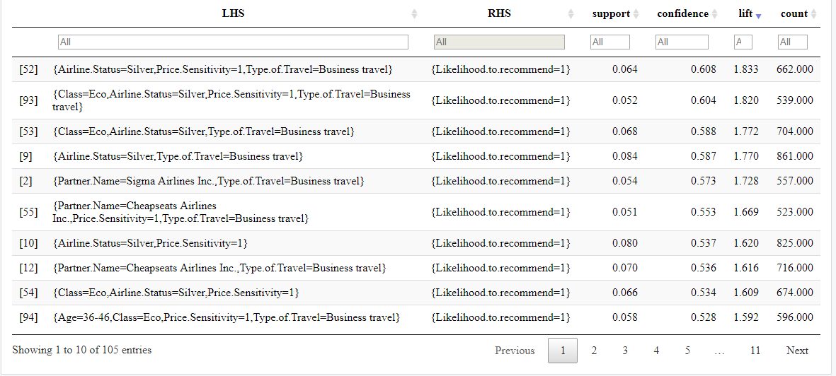
TOP 10 Associations for Y =1(Promoters)

Slide 27
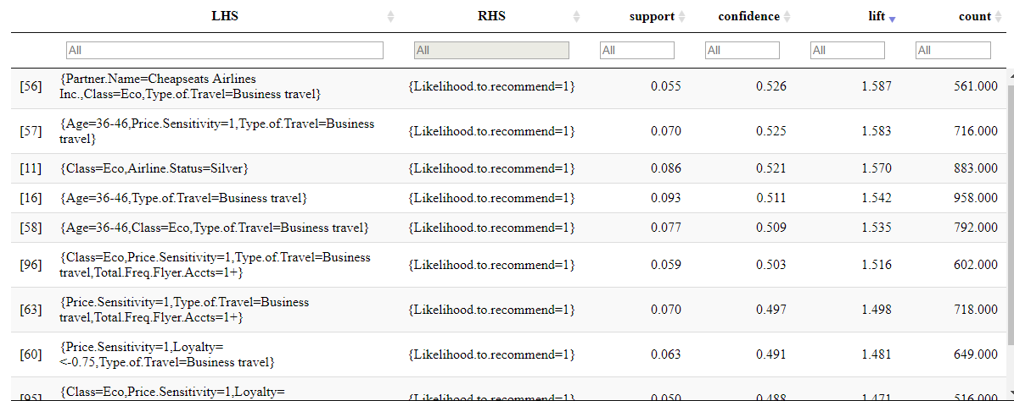
Next 10 Associations for Y =1 (Promoters)

Slide 28
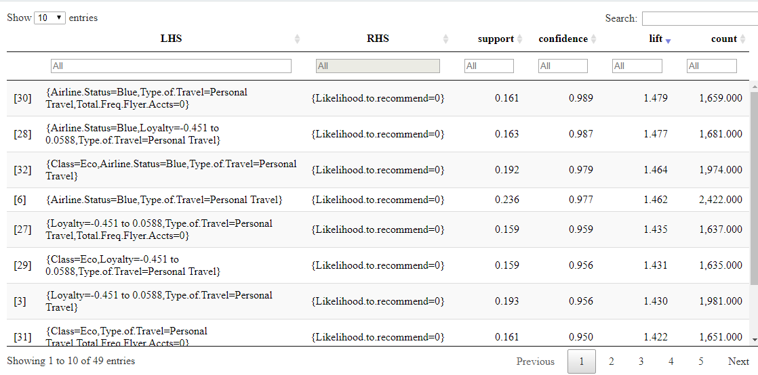
Top 10 Associations for Y =0 (Detractors)

Slide 29
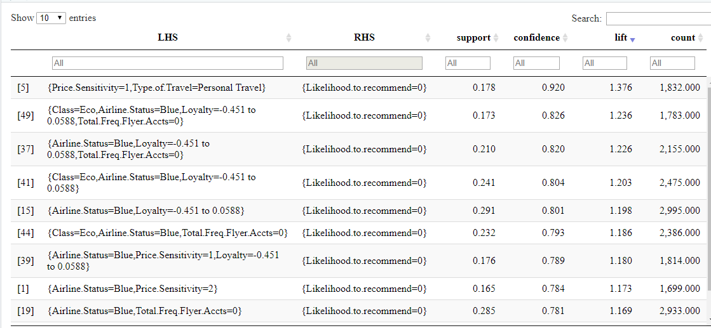
Next 10 Associations for Y =0 (Detractors)

Slide 30
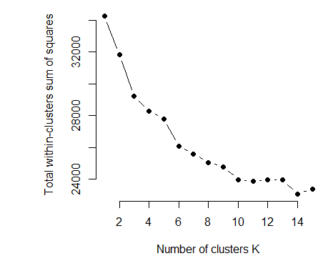
Analysis
2. Clustering Using KPrototype
Implemented a segmentation algorithm to study the following :
To club travellers with similar characteristics together. It helps us to study how the Likelihood to recommend varies within that cluster of travellers for different variables.
We want to profile each of the clusters to see what kind of travellers they are.Profiling helps us notice trends of the likelihood to recommend within the cluster.
Optimum Number of clusters : 4

Slide 31
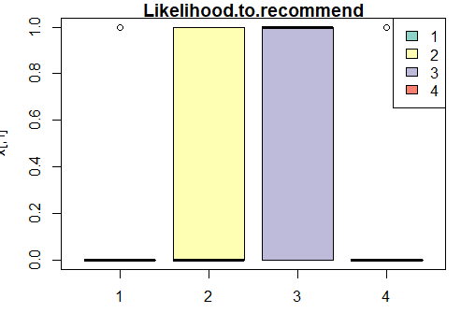
Cluster Profile Plots
The 4 colours represent the 4 clusters and the bars represent the value of Likelihood to Recommend in each of the 4 clusters.
This plot tells us that Cluster 1 and 4 are Detractor clusters ,ie: Likelihood to recommend = 0
and cluster 2 and 3 are promoter clusters ,ie : Likelihood to recommend = 1.
We look at the other X variable’s distribution across clusters. If they are significaantly populous in clusters 1 an 4 , they are detractors, else promoters

Slide 32
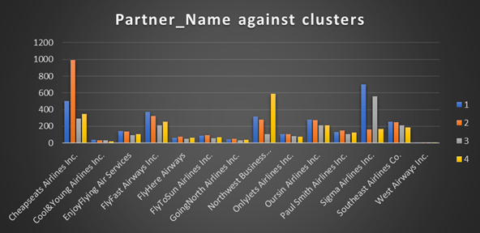
We have conclusive evideence that Cheapseats Airline Travellers are Promoters.
Northwest Business Airline travellers are Detractors.

Slide 33
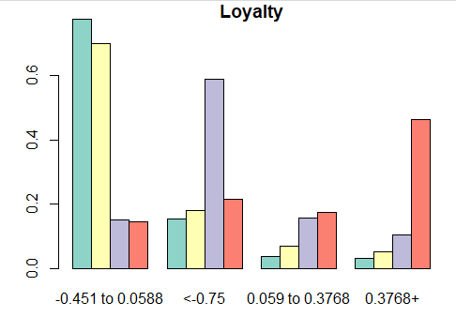
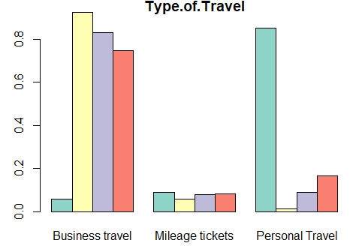
Personal Travellers are detractors and Business Travellers are predominantly promoters
Travellers with high Loyalty are surprisingly detractors and Very less loyal customers are promoters

Slide 34
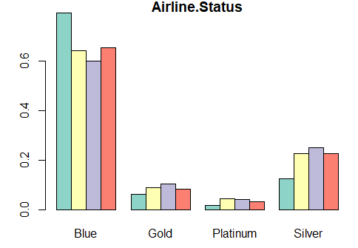
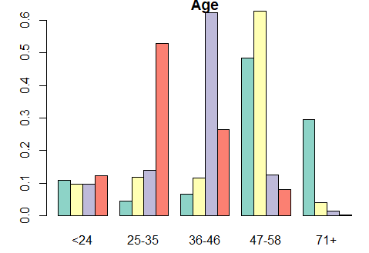
Platinum ,Silver and Gold Airline Status and are promoters
Blue Travellers are detractors
Age group 25- 35 and 71 + detractors.
36-58 age group are Promoters

Slide 35
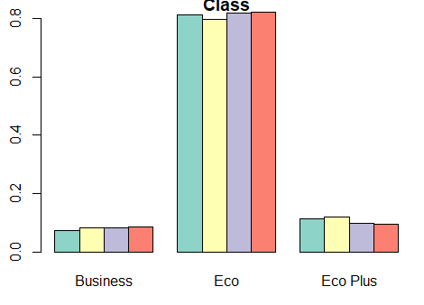
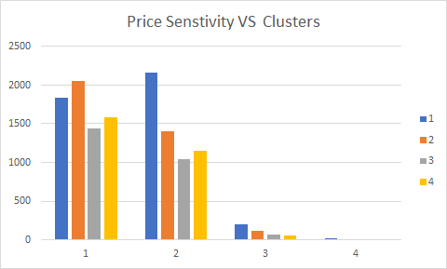
Promoters Have high Price Sentivity(1)
Promoters Have high Price Sentivity(1)
Eco Plus Users are slight promoters

Slide 36
Statistical Inference from our Models

Slide 37
Conclusively:
Business travellers and price sensitive customers are more likely to recommend Southeast Airlines.
Northwest Business Airline Travellers has been failing in comparison to other partners.
Age based price discrimination may help decrease the number of detractors for 18-24 and 71+ years age groups.
A ‘first impression’ price discount may help decrease detractors who are Blue class flyers.
Eco Plus seems to be an effective offering to increase the likelihood to recommend.

